Slide 1
Degree of Relationship in DBMS
10

Slide 2
Type of attribute
Relationship
Degree of relationship

Slide 3
Relationship
We are related to things around us in some or the other way. We are related to our family, friends, etc. and these relationships are of different kinds. For example, you and your father are related. There is a parent-child relationship between you. You have only one father but he may have many children. You and your siblings are related. You and your teacher are related. The teacher teaches you as well as many other students. You also study from different teachers.
A relationship represent an association between two or more entities.

Slide 4
Relationship
We are related to things around us in some or the other way. We are related to our family, friends, etc. and these relationships are of different kinds. For example, you and your father are related. There is a parent-child relationship between you. You have only one father but he may have many children. You and your siblings are related. You and your teacher are related. The teacher teaches you as well as many other students. You also study from different teachers.
A relationship represent an association between two or more entities. Any association between two entity types is called a relationship. Entities take part in the relationship. It is represented by a diamond shape.
For example, A teacher teaches students. Here, "teaches" is a relationship and this is the relationship between a Teacher entity and a Student entity.

Slide 5

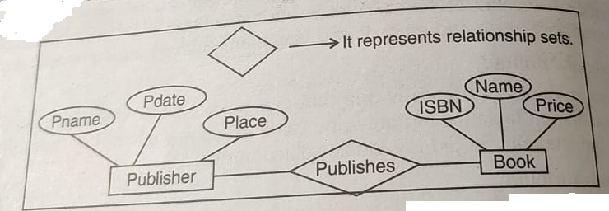
Relationship
We are related to things around us in some or the other way. We are related to our family, friends, etc. and these relationships are of different kinds. For example, you and your father are related. There is a parent-child relationship between you. You have only one father but he may have many children. You and your siblings are related. You and your teacher are related. The teacher teaches you as well as many other students. You also study from different teachers.
A relationship represent an association between two or more entities. Any association between two entity types is called a relationship. Entities take part in the relationship. It is represented by a diamond shape.
For example, A teacher teaches students. Here, "teach/teaches" is a relationship and this is the relationship between a Teacher entity and a Student entity.

Slide 6
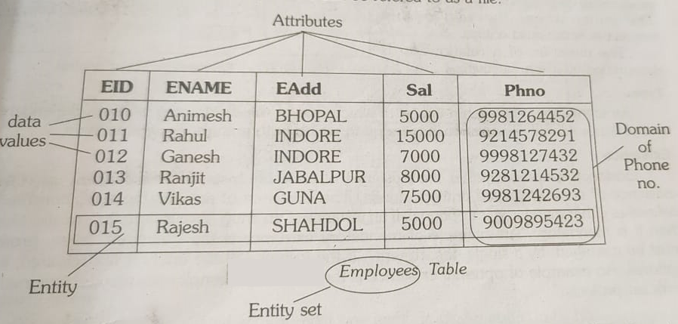
Relationship

Slide 7
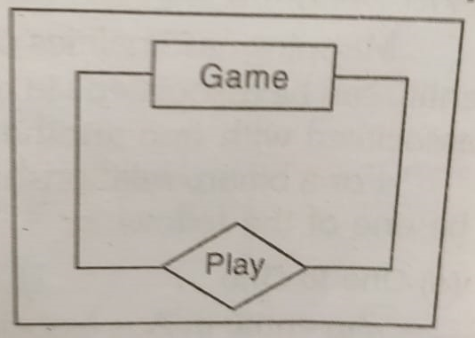
Degree of Relationship
The degree of a relationship is the number of entities associated with the relationship. The n-array relationship is the general form for degree n. Special cases are the binary and ternary where the degree is 2 and 3 respectively.
Unary Relationship

Slide 8
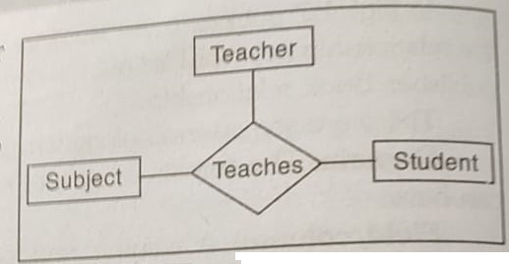
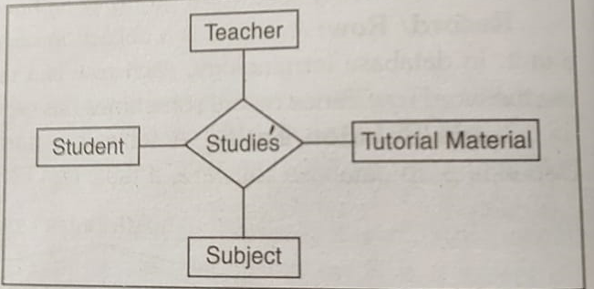
Degree of Relationship
Binary Relationship
Ternary Relationship
Quaternary Relationship

Slide 9
Direction, Type and Existence
Direction: The direction of a relationship indicates the originating entity of a binary relationship. The entity from which a relationship indicates the originating entity of a binary relationship. The entity from which a relationship originates is the parent entity. The entity where the relationship terminates is the child entity. The direction of a relationship is determined by its connectivity.
Type: An identifying relationship is one in which one of the child entity is also a dependent entity. A non-identifying relationship is one in which both entities are independent.
Existence: Existence denotes whether the existence of an entity instance is dependent upon the existence of another related entity instance. It is either mandatory or optional.

Slide 10


